Slide 1
Setting Up Recurring Reports in SpearMart

Slide 2
Setting Up a Recurring Report
Export reports can be scheduled to recur on a regular basis
Saved search exports can be scheduled to recur
A saved search that uses a data range of Last Month or Last Week is eligible for recurring exports.
Last Month - When you create a recurrence on a saved search with a date range of Last Month, a monthly export is created. Monthly extracts should be available on the 2nd of each month.
Last Week (Sun – Sat) – When you create a recurrence on a saved search with a date range of Last Week a weekly scheduled extract will be created. Weekly extracts will be queued to run Sunday at 12:01 am. Depending on the number of extracts scheduled completion time may vary, but should be available no later than Monday at noon.
A recurring export can be configured only from a user's personal saved searches only.
Scheduled recurring extracts can be deleted and will expire one year from the date they were created.

Slide 3
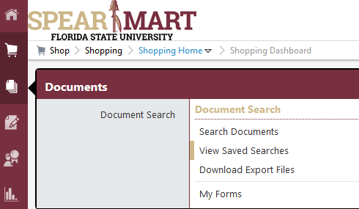
Setting Up a Recurring Report
Log in to myFSU>SpearMart
Then click the Documents icon in the left column, Document Search, Search Documents

Slide 4
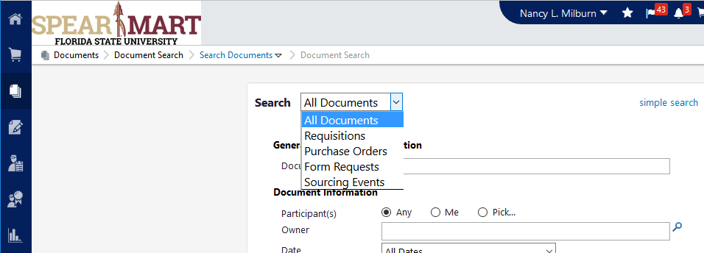
Setting Up a Recurring Report
When the search screen comes up, it may be in the simple search format as shown above. Click the “advanced search” link under the blank field to expand so you have more fields to select from
Then select the type of document you want to search for from the choices as shown

Slide 5
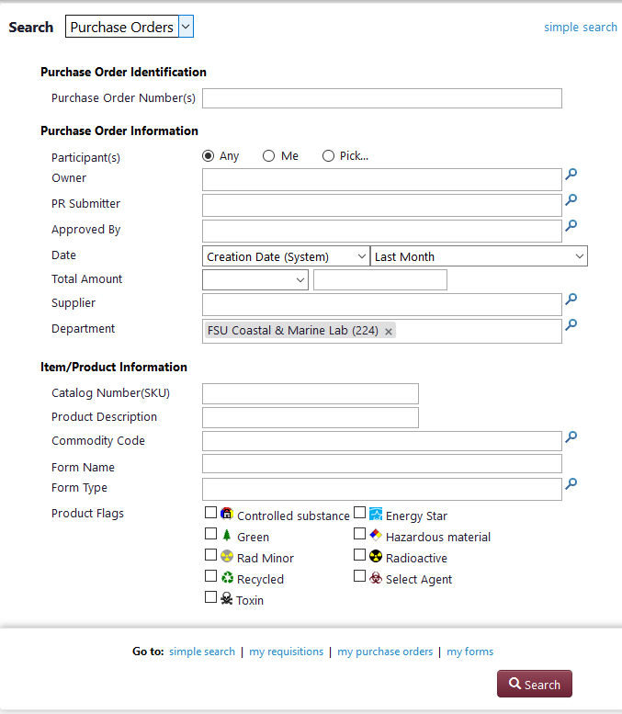
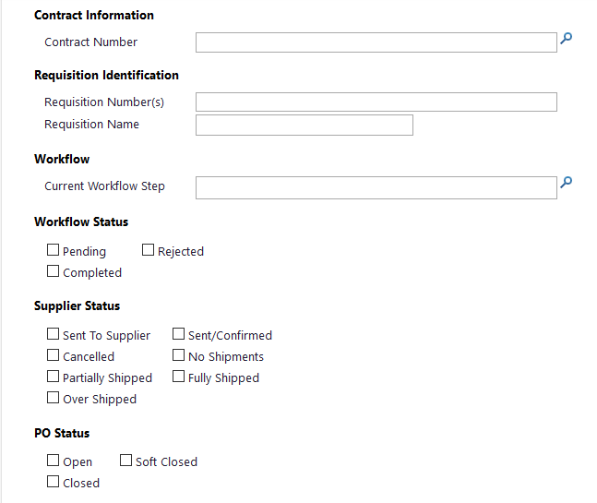
Setting Up a Recurring Report
For this example, we are searching for all Purchase Orders processed on the Department’s budget within the past month
There are numerous options for these reports as shown below

Slide 6
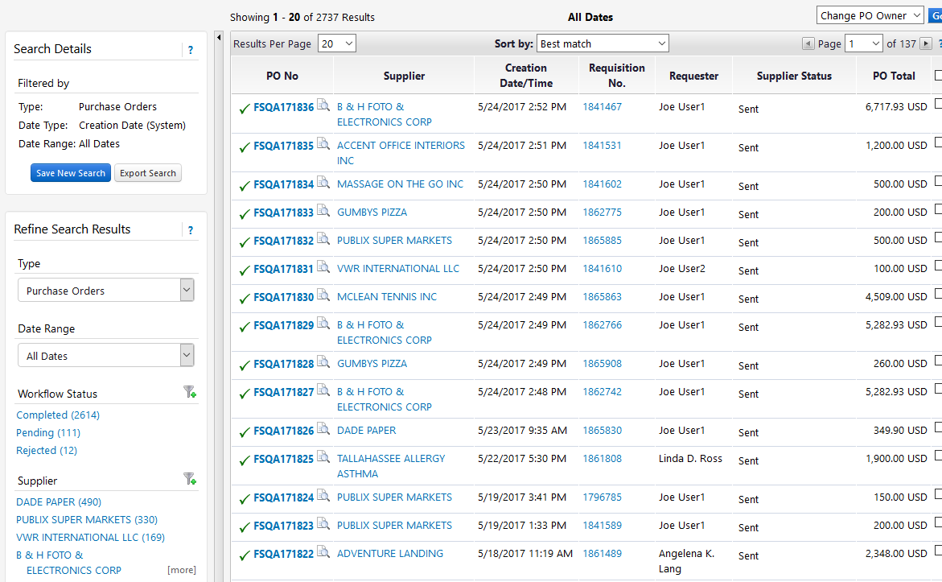
Setting Up a Recurring Report
To save this report, click “Save New Search”

Slide 7
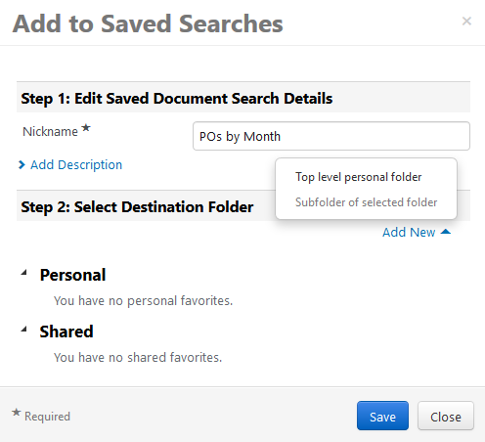
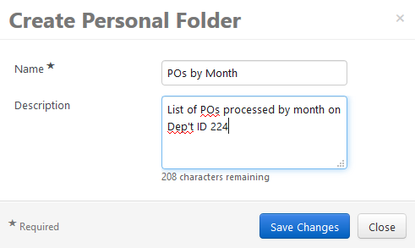

Slide 8
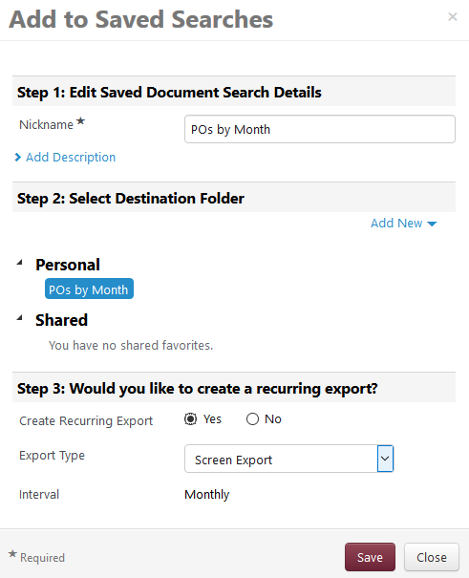

Slide 9
When you click to go to the download page, the item will show up with Pending status
When the report has downloaded, you can click the blue link to open the report in Excel and save as needed
You will get notified that you have a report ready each week or month when the scheduled report runs

